Slide 1
ALUMINIUM-AIR BATTERIES: Innovation in Energy Storage. Presented by krrishh Shirbhaiye & yash Kamble

Slide 2
agenda
Introduction
Working
Advantages
Advantages
Applications
Comparison with other tech.
Future Prospects
Conclusion

Slide 3
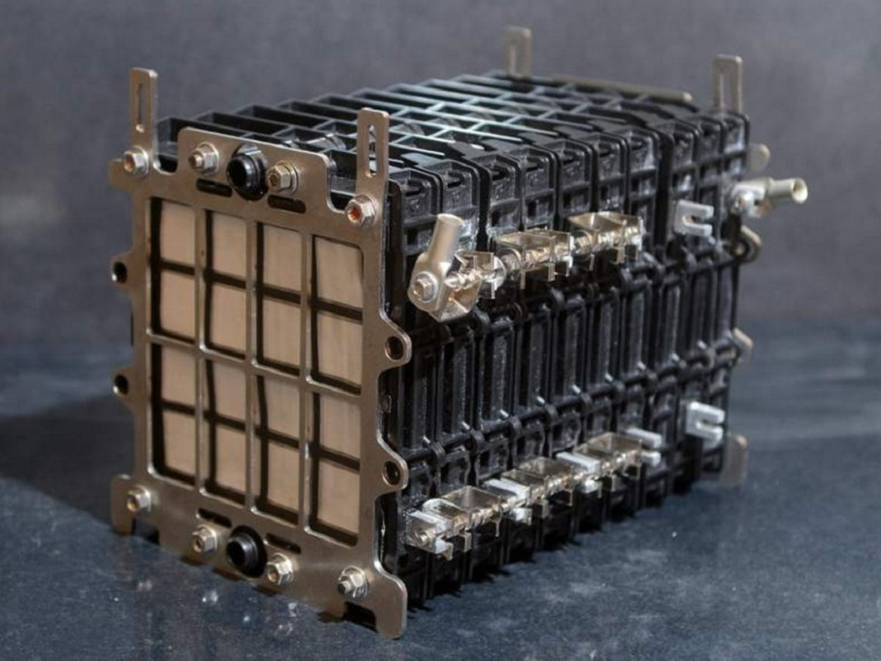
Introduction to Aluminum-Air Batteries What is an Aluminum-Air Battery? A metal-air electrochemical battery uses aluminum as the anode and oxygen from the air as the cathode. The battery generates electricity from the oxidation of aluminum with oxygen.

Slide 4
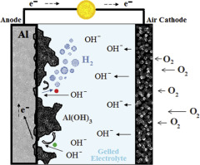
How Aluminum-Air Batteries Work?
Working Principle:
Anode Reaction:
Aluminum (Al) reacts with hydroxide ions (OH⁻) to form aluminum hydroxide (Al(OH)₃) and release electrons.
Cathode Reaction:
Oxygen from the air reacts with water to form hydroxide ions (OH⁻) while accepting electrons.
Overall Reaction:
4Al+3O2+6H2O→4Al(OH)3+Electricity(2.71V)
Illustration of the battery structure:
Anode:
Aluminum plate.
Electrolyte:
Aqueous solution typically contains a strong base like potassium hydroxide (KOH).
Cathode:
Porous air electrode.

Slide 5
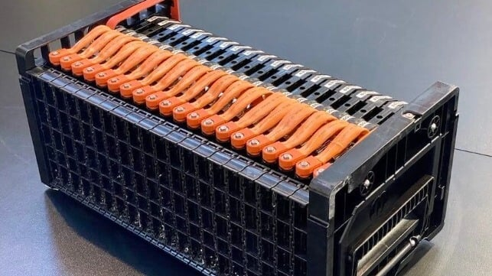
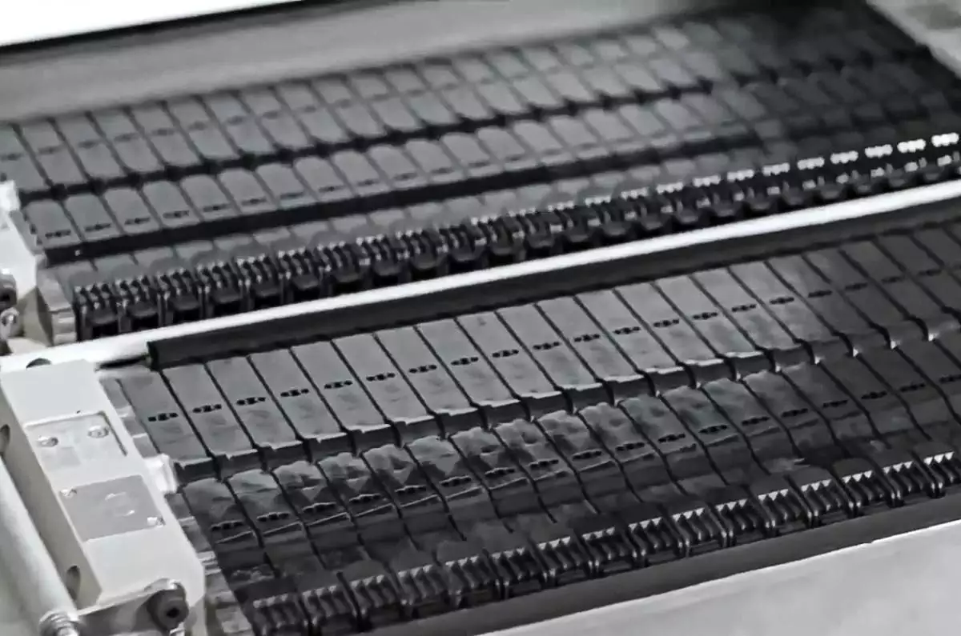
Advantages of Aluminum-Air Batteries
High Energy Density.
Lightweight and Cost-Effective
Environmentally Friendly
Simplicity

Slide 6

Challenges Facing Aluminum-Air Batteries
Limited Rechargeability
Corrosion Issues
Limited Power Output

Slide 7
Applications of Aluminum-Air Batteries
Electric Vehicles (EVs)
Backup Power
Military Use
Remote Locations

Slide 8
Comparison with Other Battery Technologies
Lithium-Ion vs. Aluminum-Air:
Energy Density: Aluminum-air batteries have higher energy density.
Cost: Aluminum air is generally cheaper due to abundant aluminum.
Rechargeability: Lithium-ion batteries are rechargeable, while aluminum-air batteries are not easily rechargeable
Fuel Cells vs. Aluminum-Air:
Energy Source: Fuel cells use hydrogen or other fuels, whereas aluminum-air batteries use metal and oxygen from the air.
Efficiency: Fuel cells can be more efficient, but aluminum-air batteries are simpler and more cost-effective.

Slide 9
Future Prospects and Research
Current Research Areas: Improving the recyclability and rechargeability of aluminum-air batteries. Developing new electrolytes to reduce corrosion and increase lifespan. Integration into hybrid systems with other battery technologies.
Commercialization: Ongoing efforts to reduce costs and improve the practicality of aluminum-air batteries for mainstream applications. Potential breakthroughs could make aluminum-air batteries a key player in the energy storage market.

Slide 10
Conclusion
Aluminum-air batteries offer a promising alternative to traditional batteries with their high energy density and cost-effectiveness.
They face challenges, particularly with rechargeability and corrosion, but ongoing research aims to overcome these obstacles.
With further development, aluminum-air batteries could play a significant role in various industries, from electric vehicles to backup power.

